Slide 1



BOGO 13th-19th Offer Insights visualisation
View in Power BI
Last data refresh:
6/22/2023 4:46:34 AM UTC
Downloaded at:
7/3/2023 5:54:38 AM UTC

Slide 2
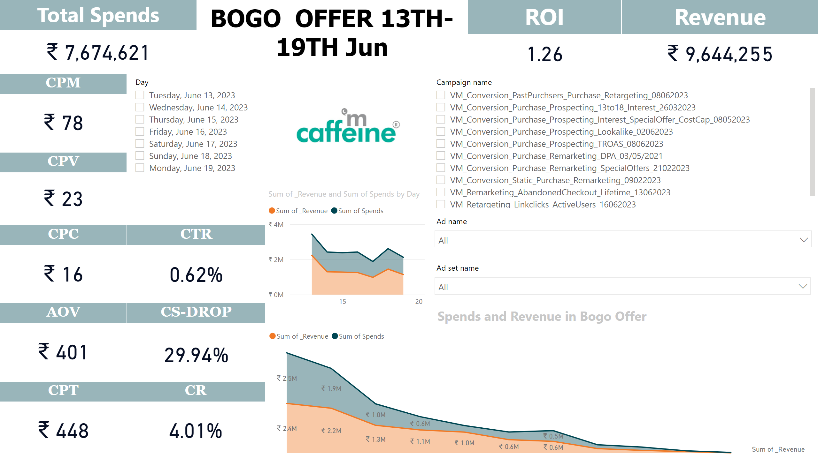
Bogo Jun Offer Insights
Notes:
Revenue
No alt text provided
Total Spends
No alt text provided
textbox
No alt text provided
ROI
No alt text provided
slicer
No alt text provided
CPM
No alt text provided
CPV
No alt text provided
CTR
No alt text provided
CPC
No alt text provided
AOV
No alt text provided
CPT
No alt text provided
CS-DROP
No alt text provided
CR
No alt text provided
slicer
No alt text provided
slicer
No alt text provided
image
No alt text provided
Spends and Revenue in Bogo Offer
No alt text provided
slicer
No alt text provided
stackedAreaChart
No alt text provided

Slide 3
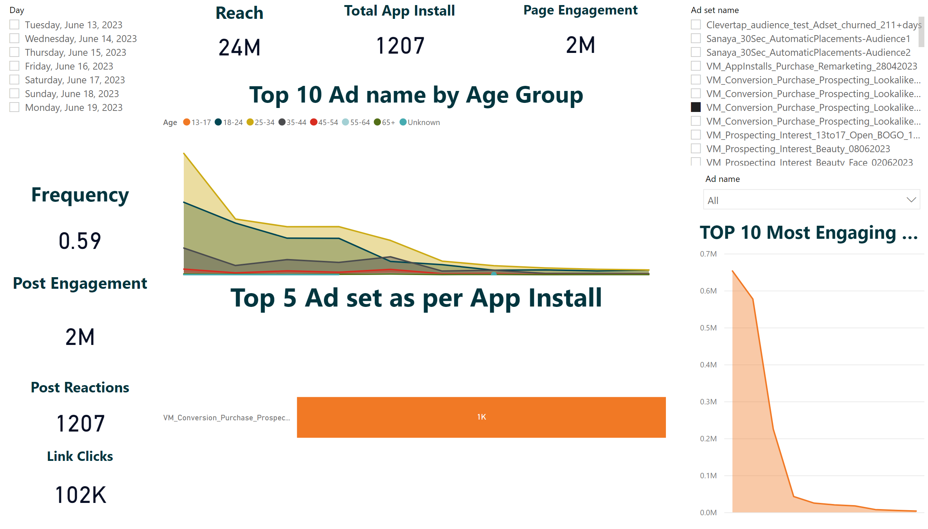
Insights
Notes:
slicer
No alt text provided
slicer
No alt text provided
slicer
No alt text provided
Total App Install
No alt text provided
Frequency
No alt text provided
Link Clicks
No alt text provided
Page Engagement
No alt text provided
Post Reactions
No alt text provided
Post Engagement
No alt text provided
Reach
No alt text provided
Top 5 Ad set as per App Install
No alt text provided
TOP 10 Most Engaging Ad
No alt text provided
Top 10 Ad name by Age Group
No alt text provided

Slide 4
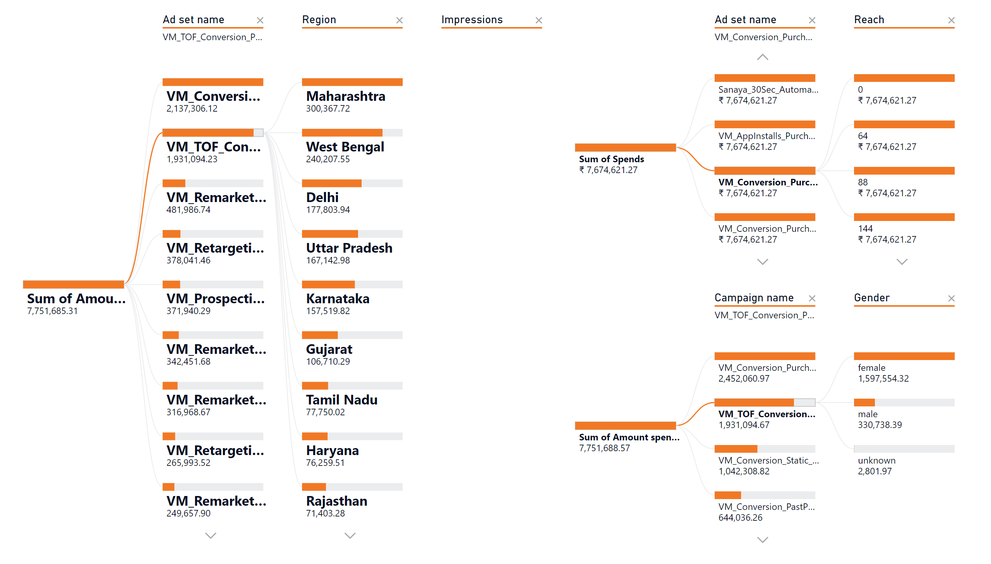
Decomposition Tree
Notes:
Top 10 Region to Target by Campaign vise
No alt text provided
decompositionTreeVisual
No alt text provided
decompositionTreeVisual
No alt text provided

Slide 5
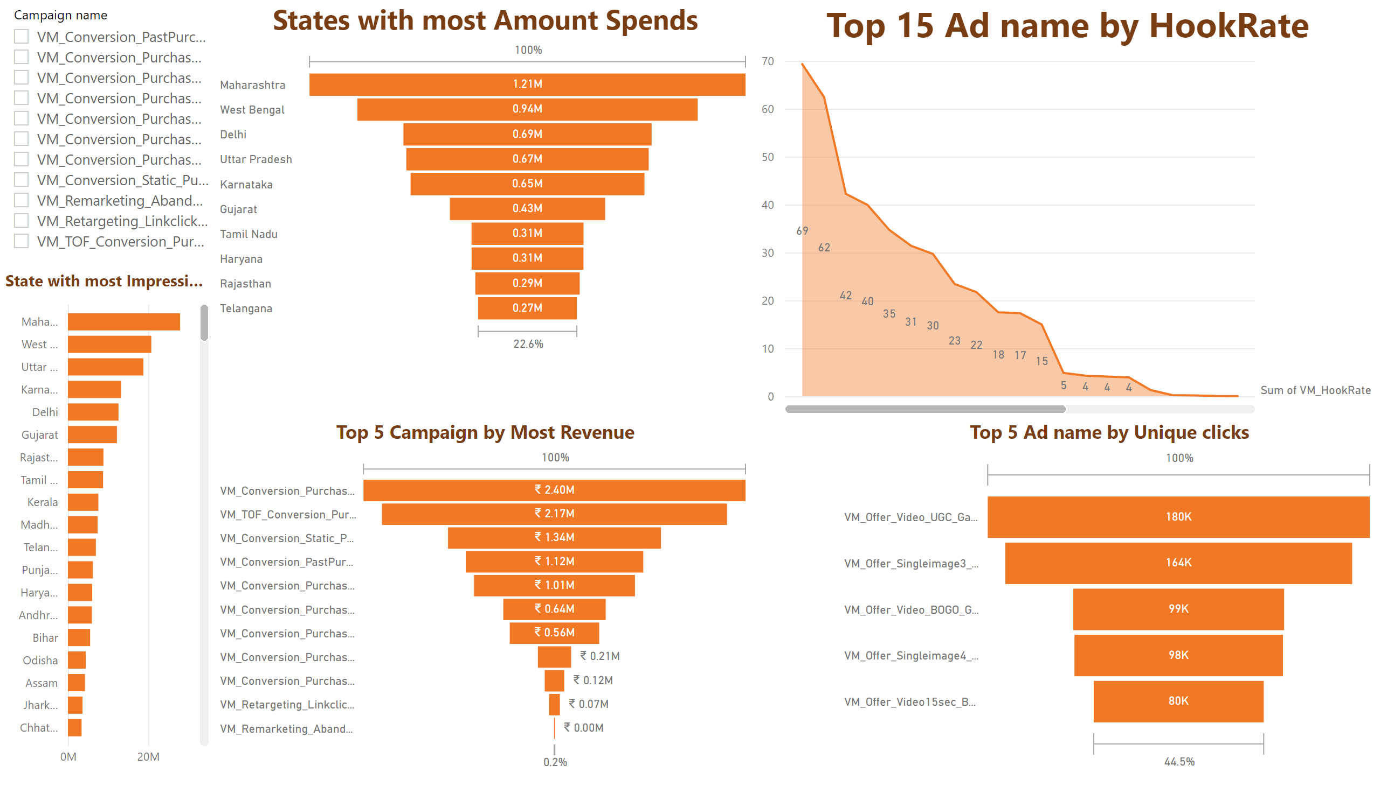
Unique Insights
Notes:
Top 15 Ad name by HookRate
No alt text provided
Top 5 Ad name by Unique clicks
No alt text provided
Top 5 Campaign by Most Revenue
No alt text provided
slicer
No alt text provided
States with most Amount Spends
No alt text provided
State with most Impressions
No alt text provided

